Slide 1
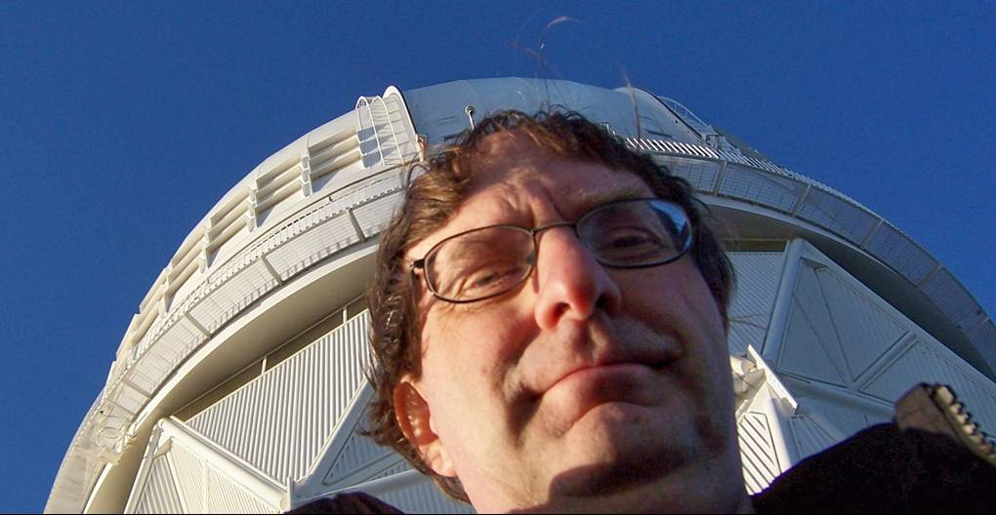
A Search for Tidal Tails in Carina
Sean MacBride¹, Carlton Pryor²
1 – Wheaton College, Massachusetts
2 – Rutgers University, New Brunswick
Notes:
Introduce everyone, thank nsf

Slide 2
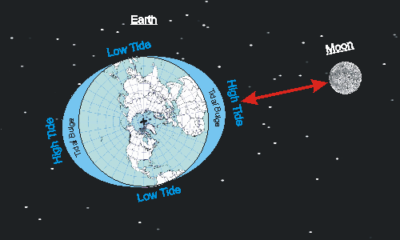
Tidal Effects
Gravity acts on mass and can cause tidal shifts
Evident in the oceans on earth
Same concept applies to objects in space
Gravity can warp matter
Gravity can warp distribution of matter in large structures
Gravity can warp light
Gravitational lensing
Notes:
Make ocean comp, correctly explain all types of warping

Slide 3
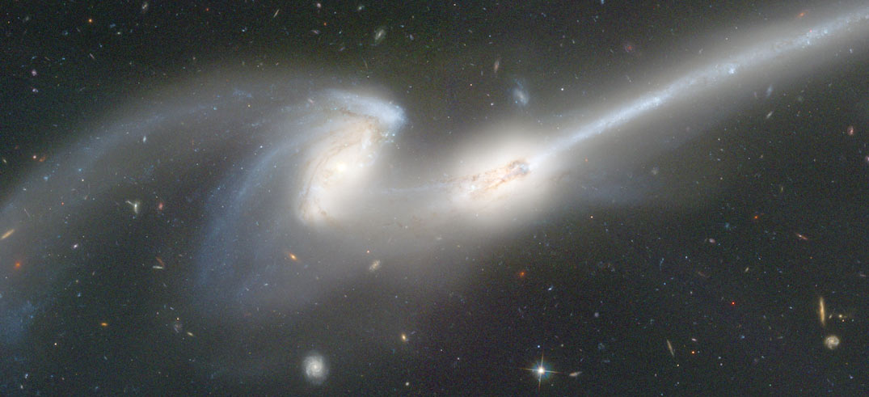
Notes:
Mice Galaxies – note large tidal tail in upper right
combined size of cores - 380 kly
with tail - 760 kly

Slide 4
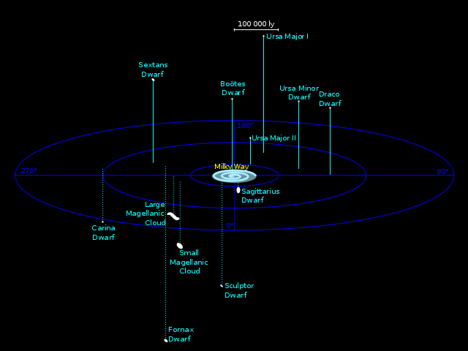
Satellite Galaxies
Orbit the galactic center of a galaxy
Still uncertainty on their formation
Can provide a wealth of information
Star formation
Large scale cosmological models
Galactic evolution
Notes:
Largest 8 kly

Slide 5
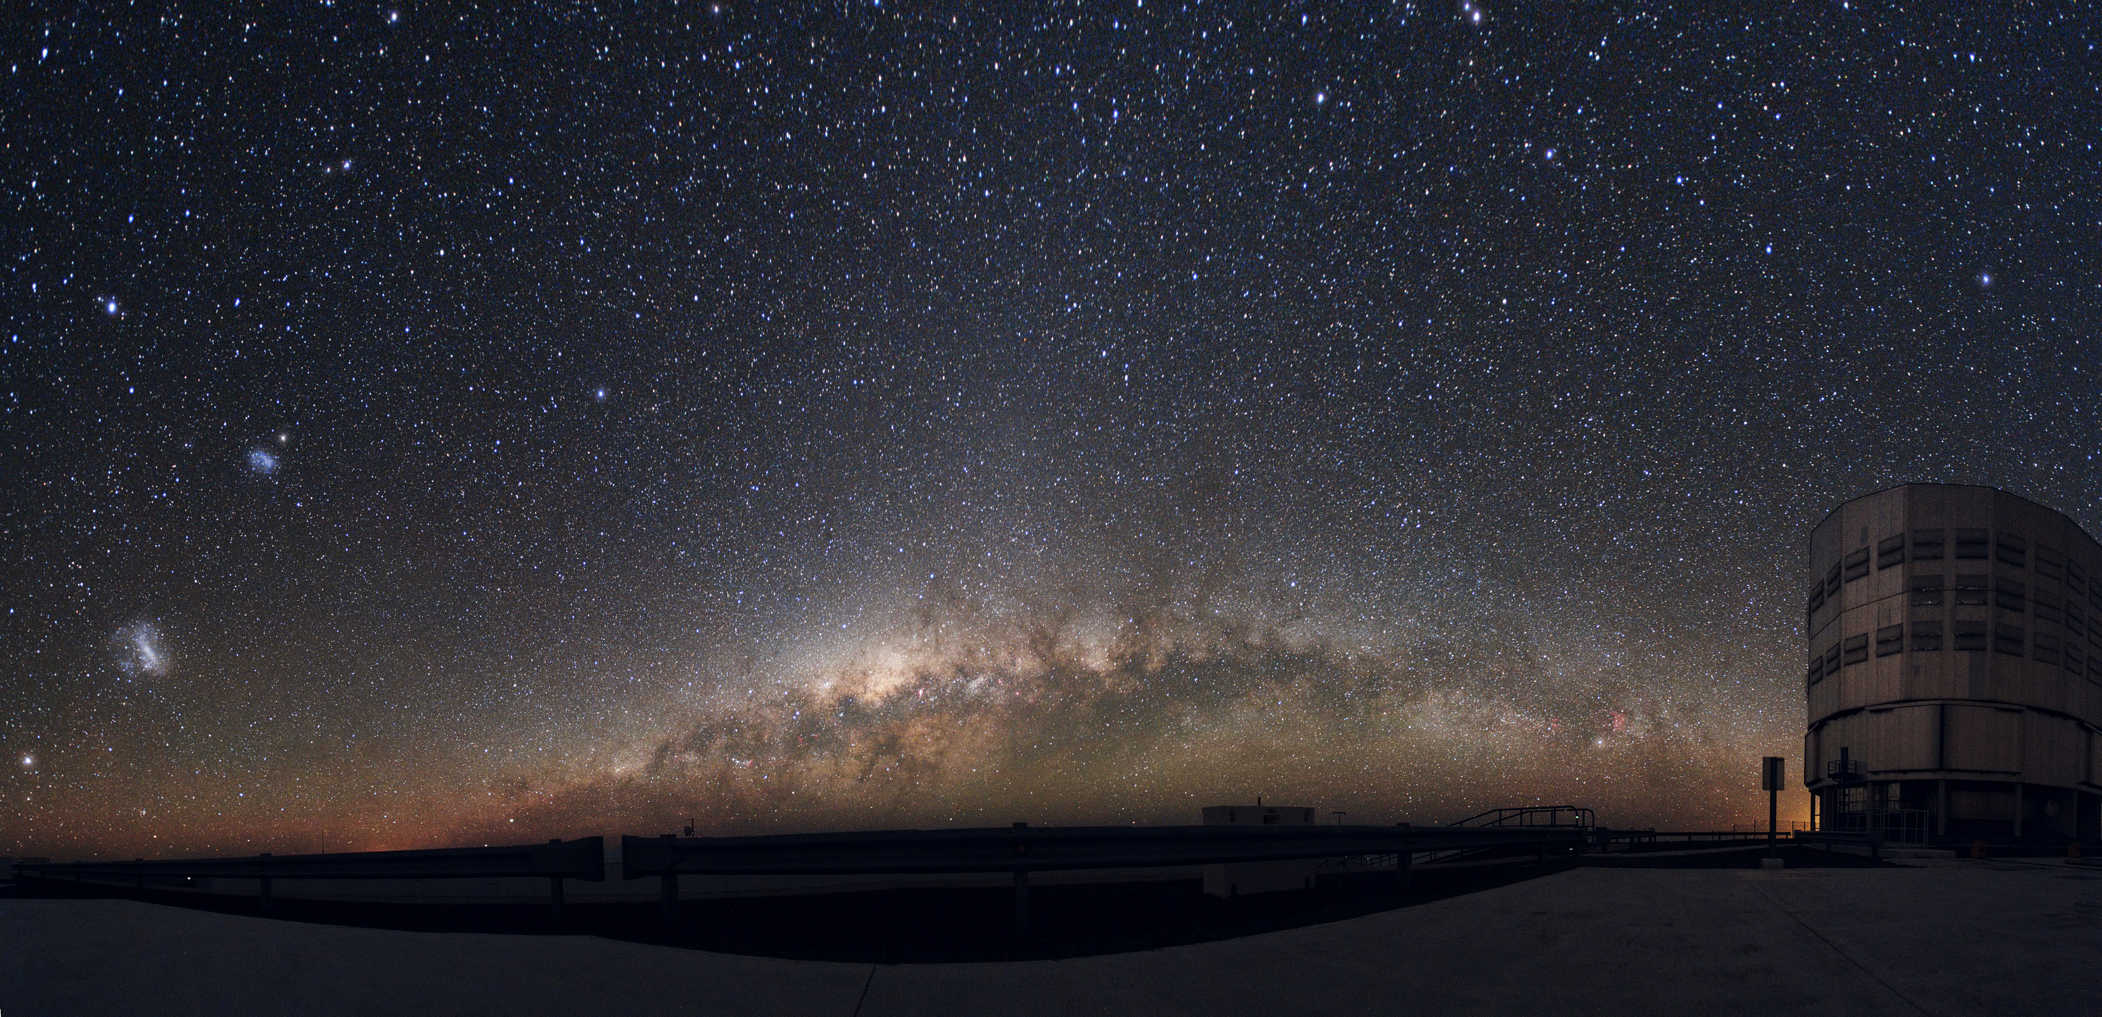
Notes:
South America’s VLT panorama with the LMC and SMC shown

Slide 6
Missing Satellite Problem
Dark Matter models give computer simulations that are relatively accurate
Simulations predict thousands of satellite galaxies, while dozens are seen
Presents astronomers with three (main) options
Our theories are wrong
The galaxies are too faint to be detected
Predicted size of galaxies is too big

Slide 7
The Carina Dwarf
1600 light years in diameter
330 ± 30 kilo-light years away
2 distinct stellar populations
13 and 3 billion years old
Low on galactic latitudes
Disk stars can pose problem

Slide 8
Notes:
Carina - ah beautiful

Slide 9
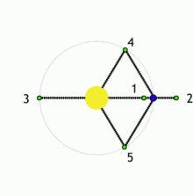
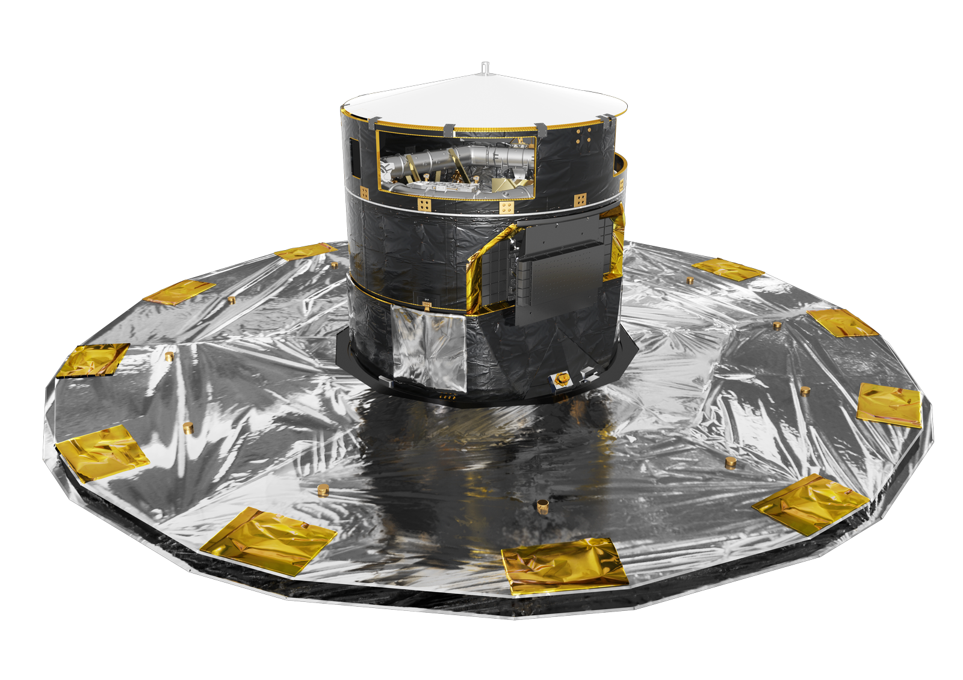

The Gaia Satellite
Launched in December 2013
Reached L2 in January 2014
Photometry and astrometry for most of the Milky Way
Telescope properties
$1.45 × 0.5$ m primary mirror
937.8 Megapixels over 106 CCD’s
Notes:
Launched from French Guiana

Slide 10
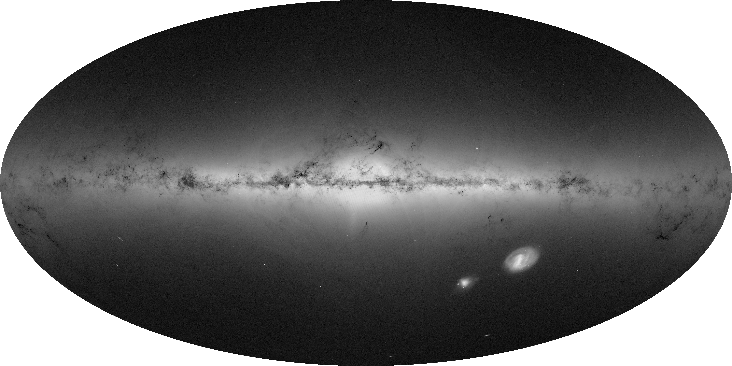

Slide 11
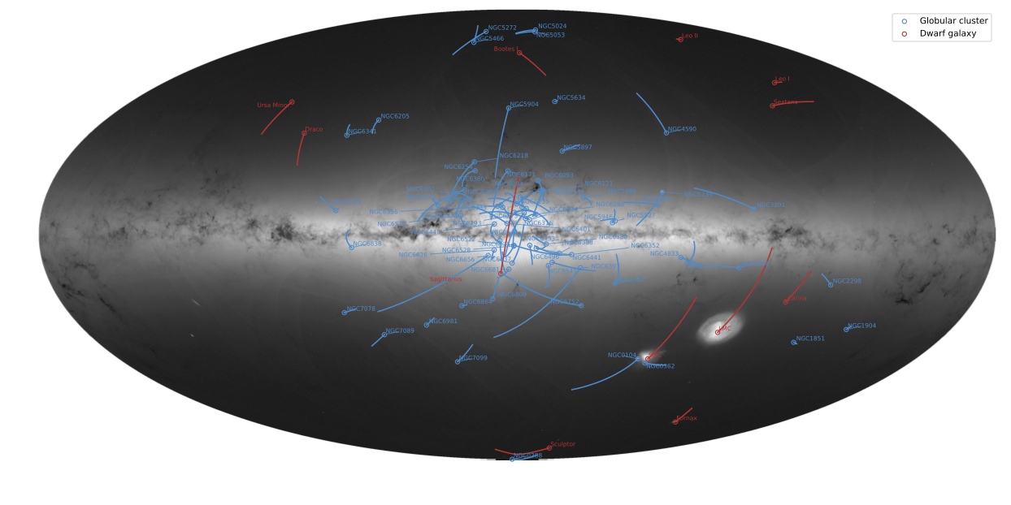

Slide 12
Summary
Gaia DR-2 provides data on 1.6 billion stars (Gaia Collaboration 2018a)
Includes proper motion and parallax
Dwarf satellite galaxies are remnants from Milky Way formation
Carina member stars indicate it was once more massive
Tidal tails could provide clues to history of Carina
Using Gaia data, we searched for low-surface-density tidal features

Slide 13
Data Flow
Gaia Raw Data
Magnitude Limit
Semimajor Axis Selection
Proper Motion Selection
Photometric Selection

Slide 14
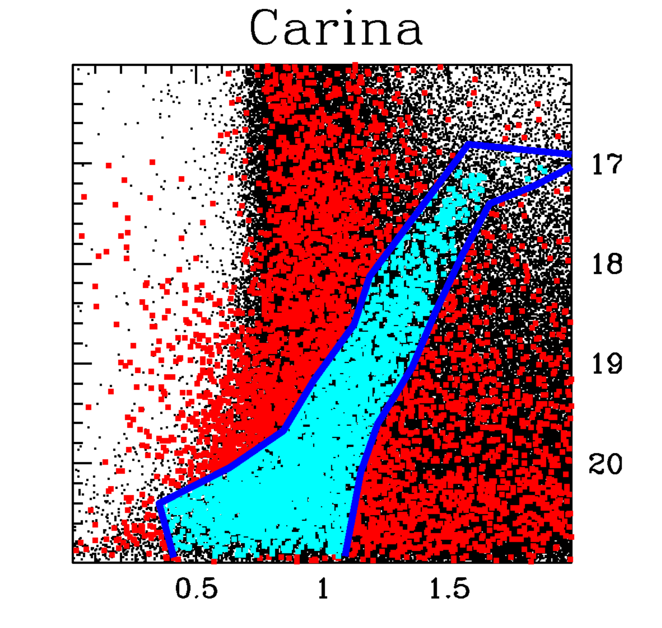
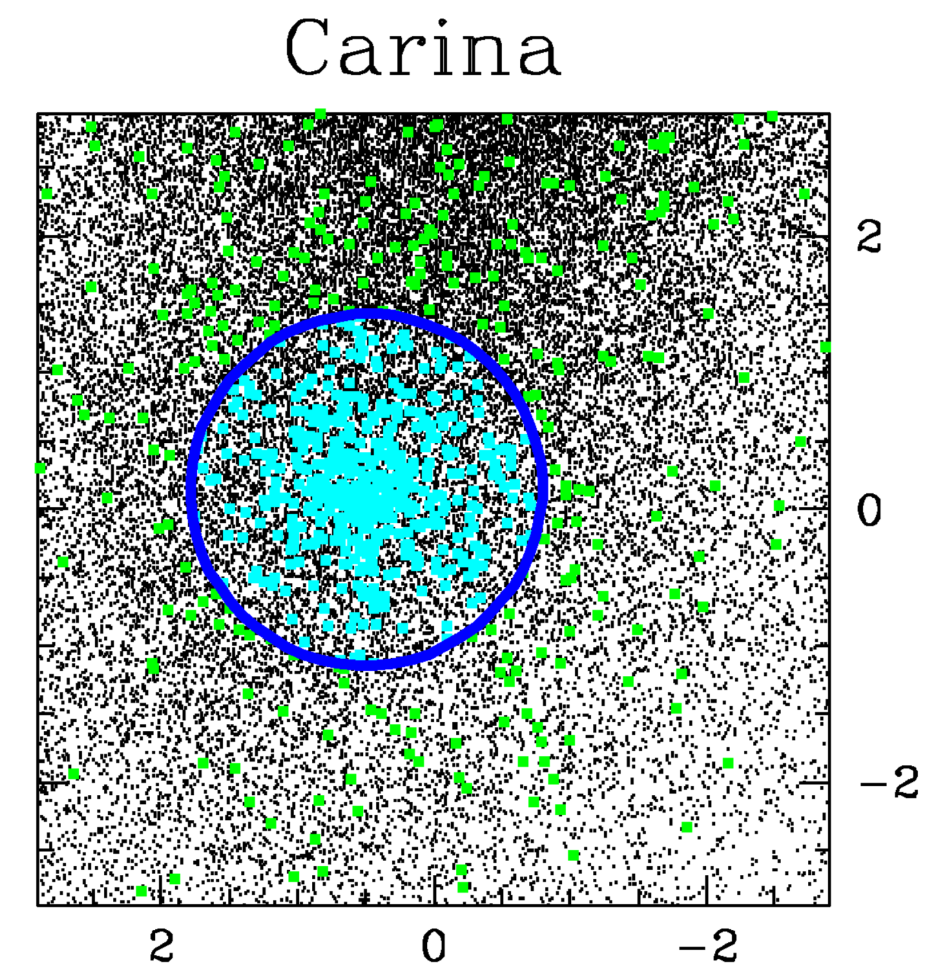
Data Flow
GAIA COLOR MAG DIAGRAM FOR CARINA HERE
μ_{δ} (mas/yr)
G-Mag
BP-RP
μ⍺ cos(δ) (mas/yr)
Gaia Collaboration et al. (2018b)
Notes:
Gaia team BP-RP and my BP-RP graph

Slide 15
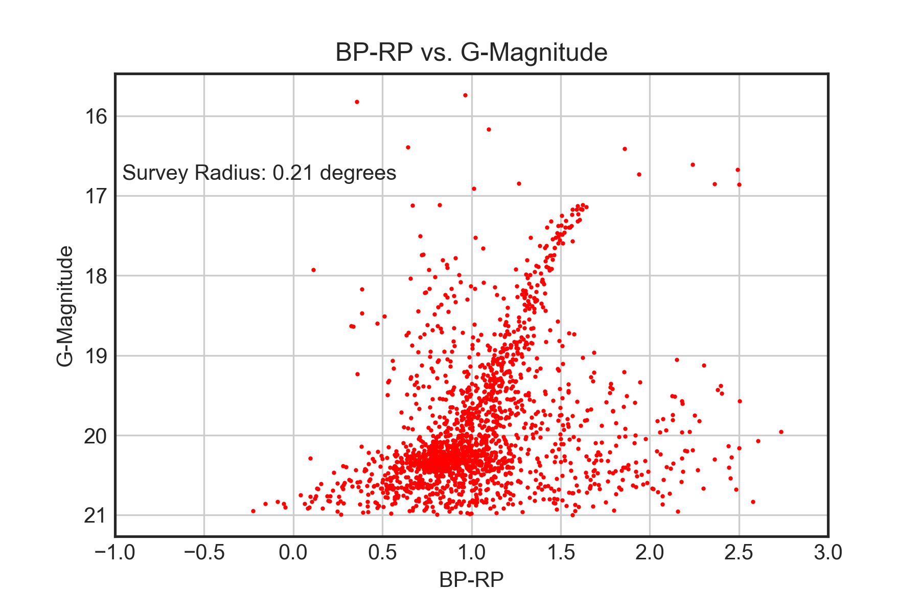
Data Flow
An initial survey radius of 0.21 degrees contains mainly Carina member stars
The color magnitude diagram clearly shows the giant branch and red clump
The diagram guided the selection of bounds

Slide 16
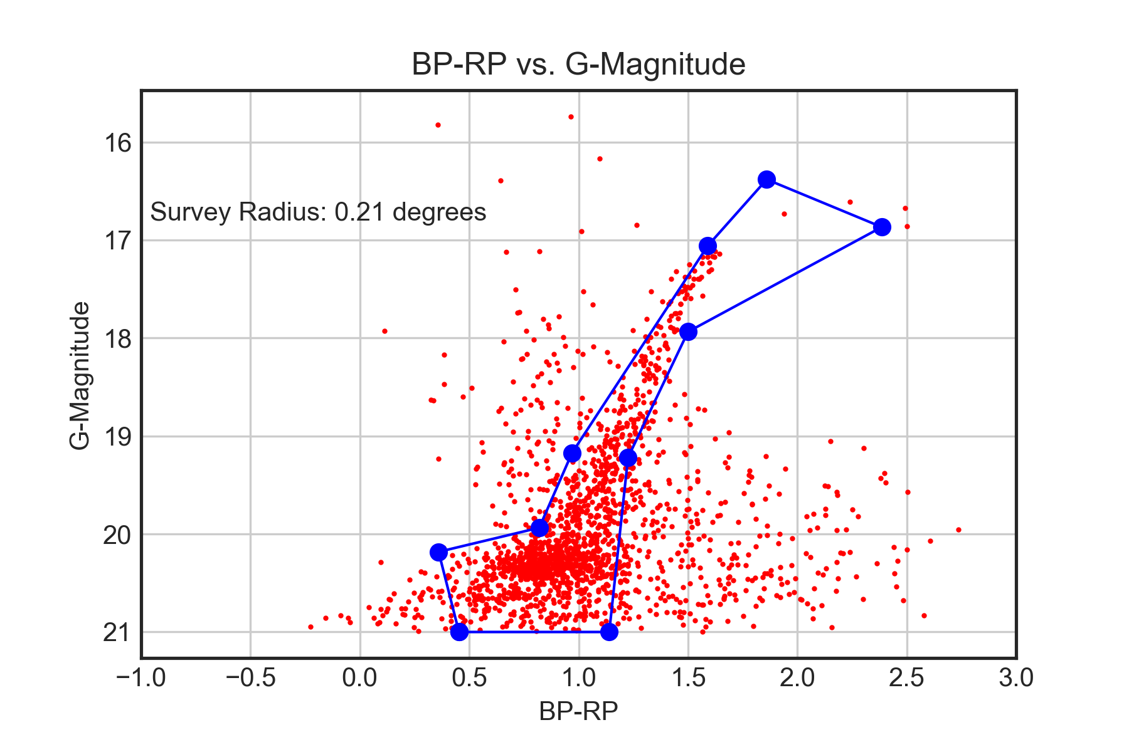
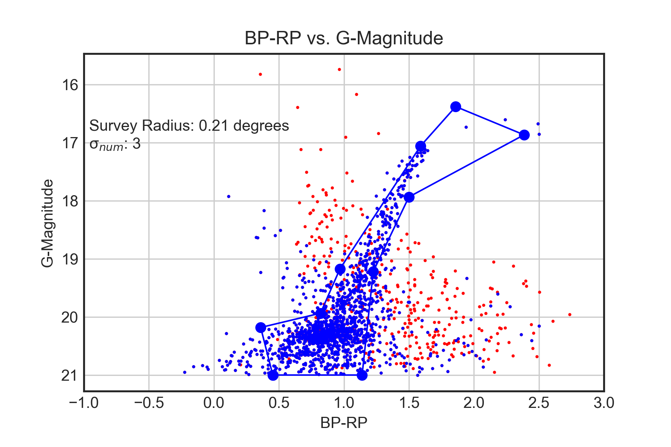
Data Flow
Bounds on the color-magnitude diagram
Proper motion selection
Notes:
Branch bounds, Sigma Cut

Slide 17
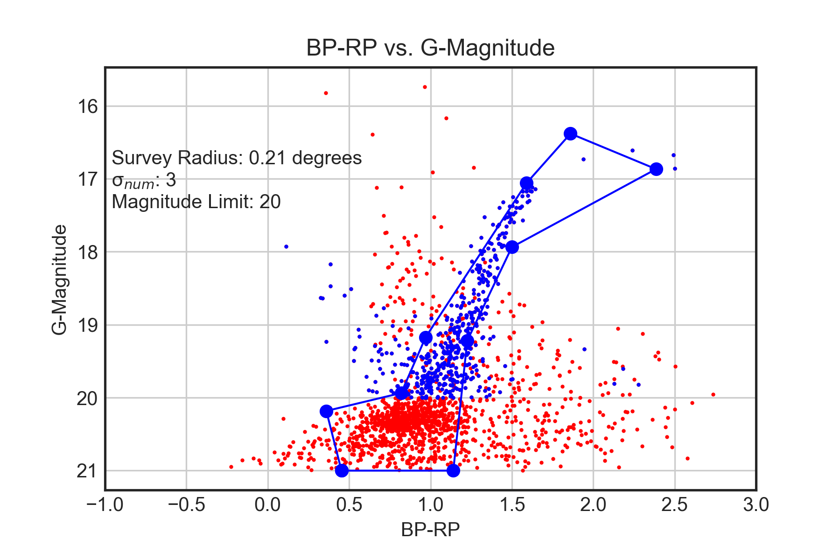
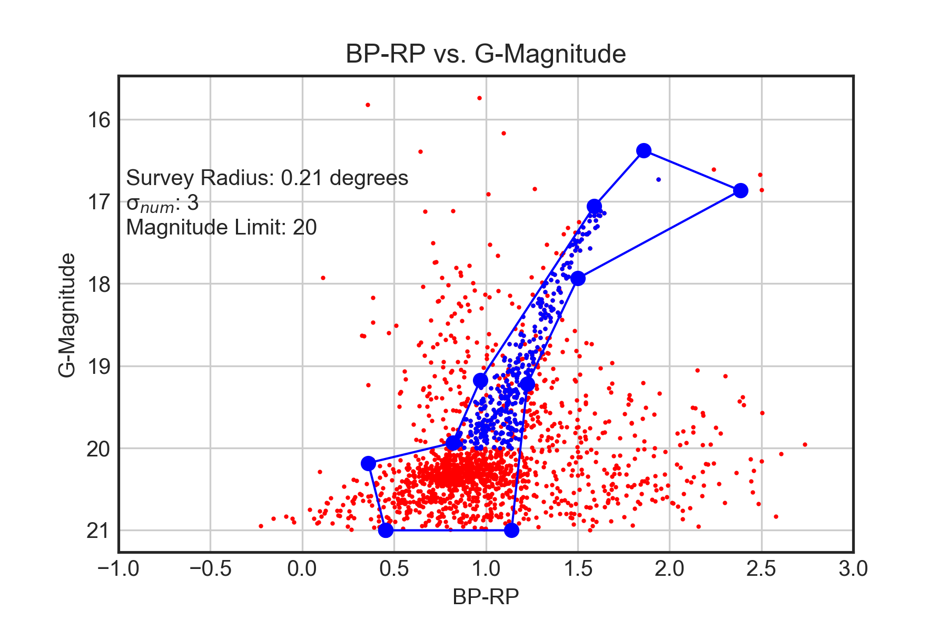
Data Flow
Magnitude limit
Photometric and Semi-major axis selection
Notes:
Maglimit, Branch and semimaj axis Limit – FINAL GRAPH

Slide 18
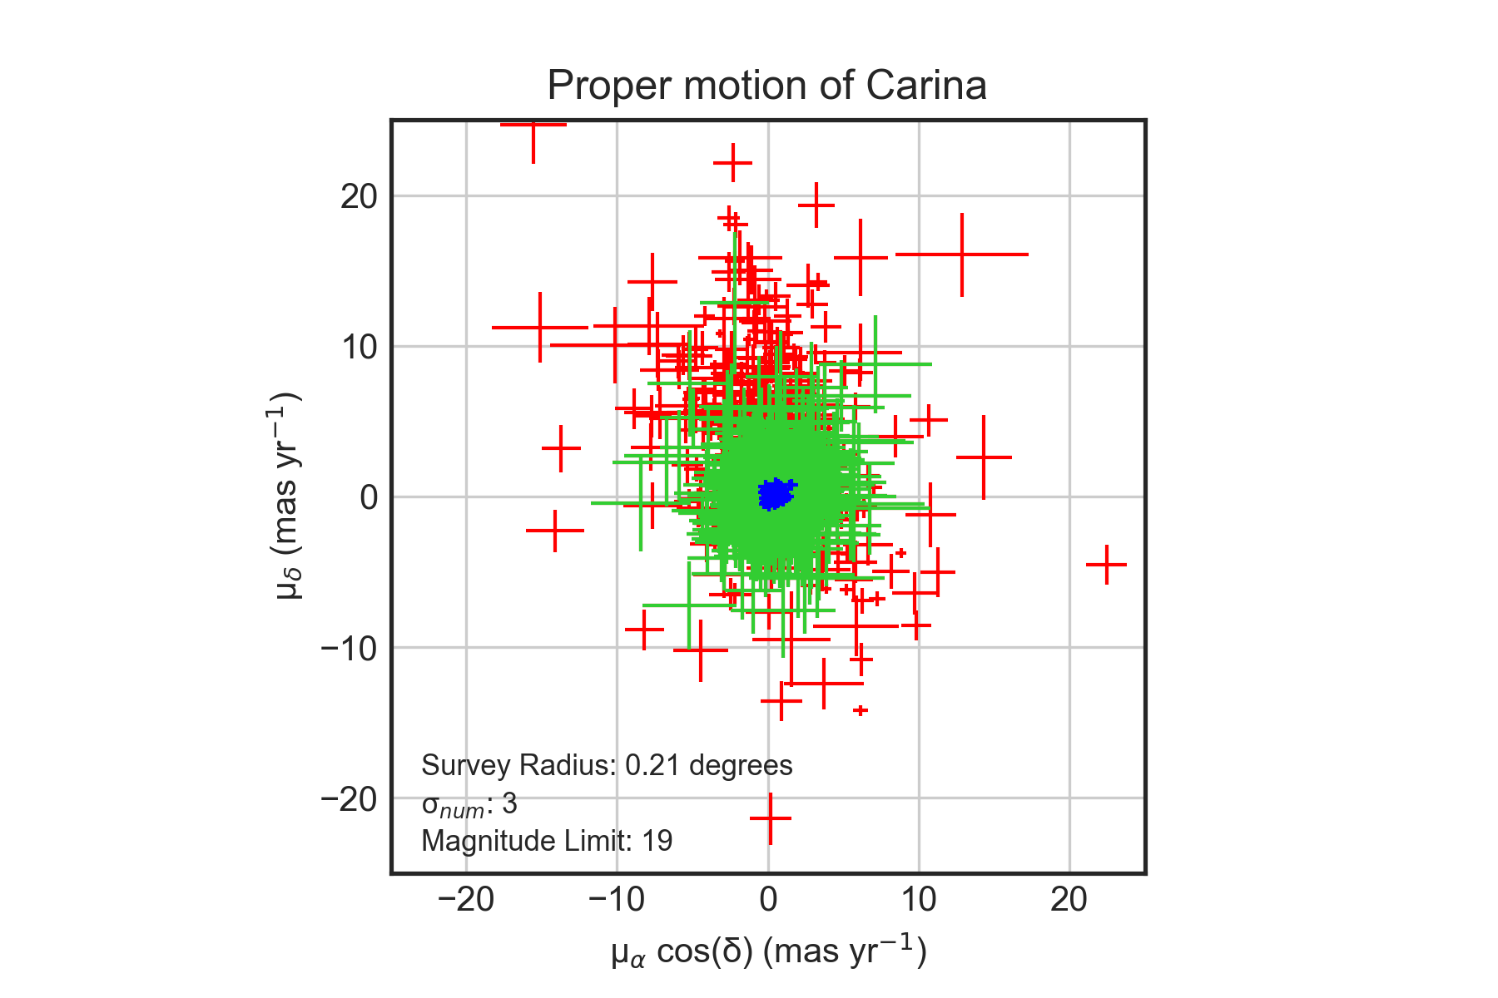
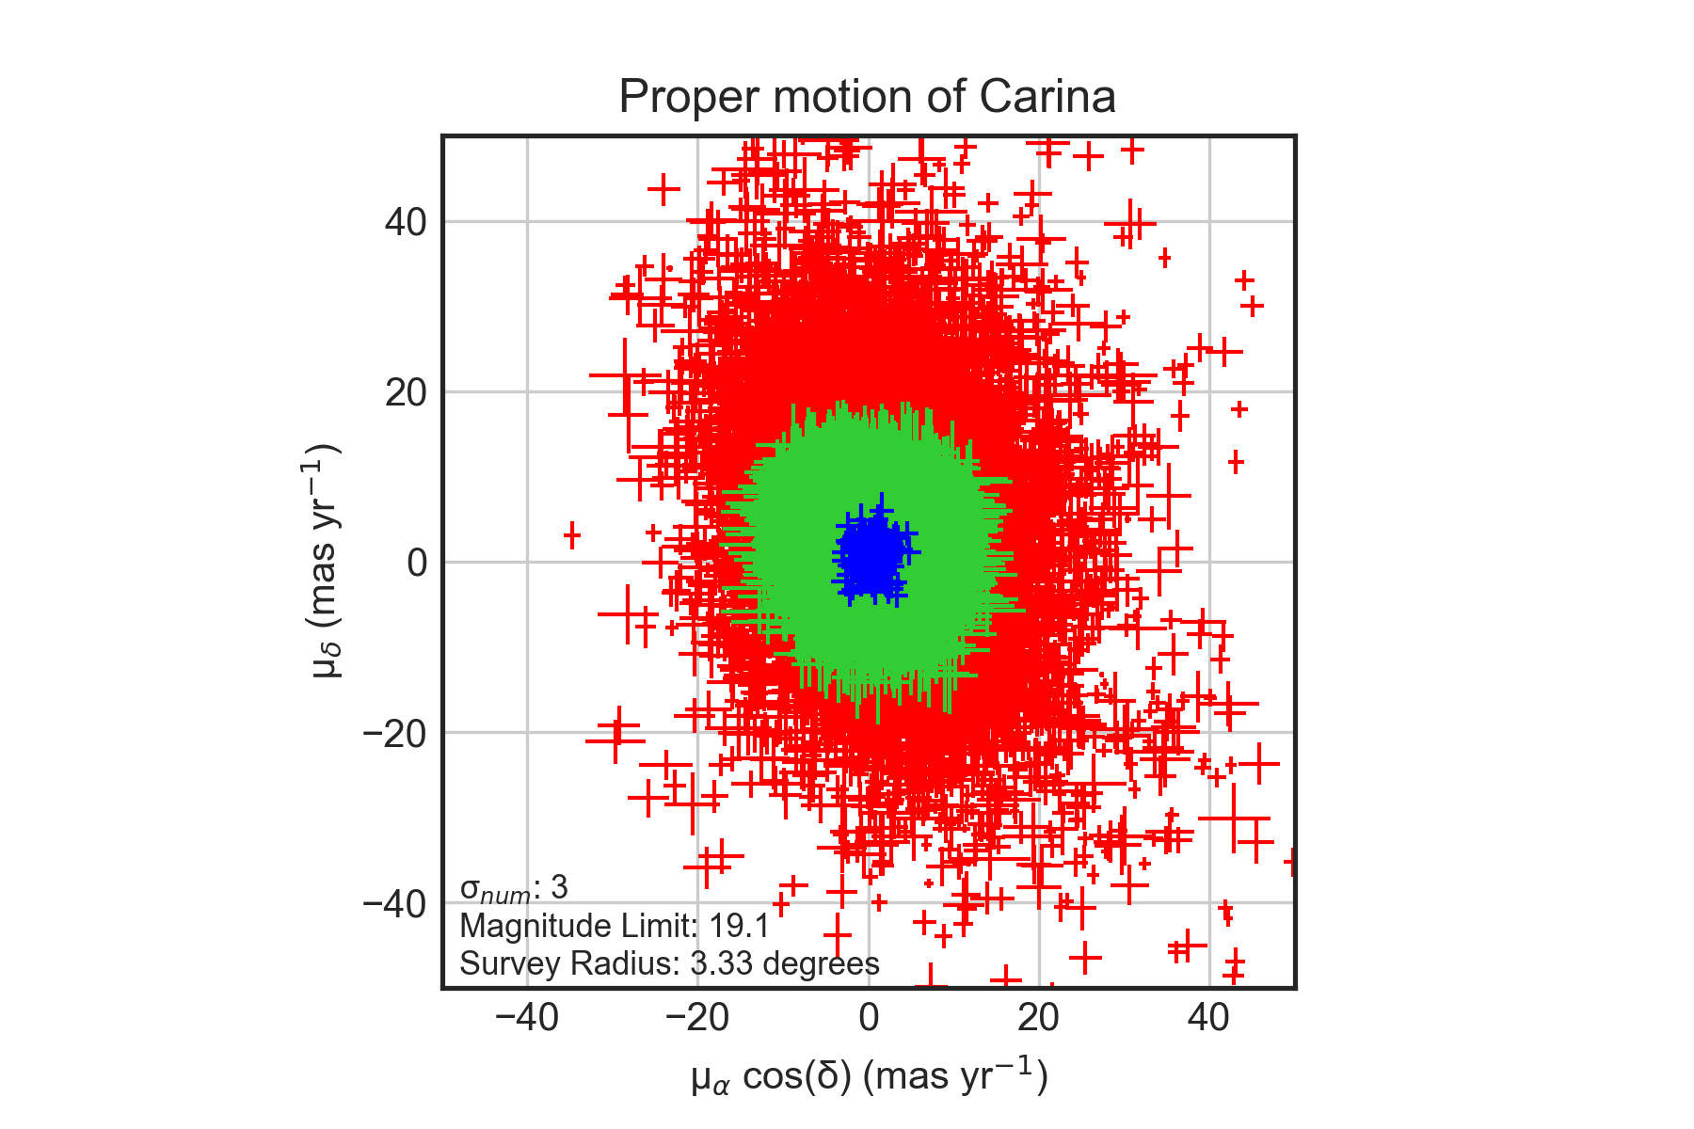
Proper Motion Problems
Notes:
Vector point plot of small radius, vector point plot of large radius
Large radius includes more stars, but has less accurate prediction of accuracy of proper motion

Slide 19
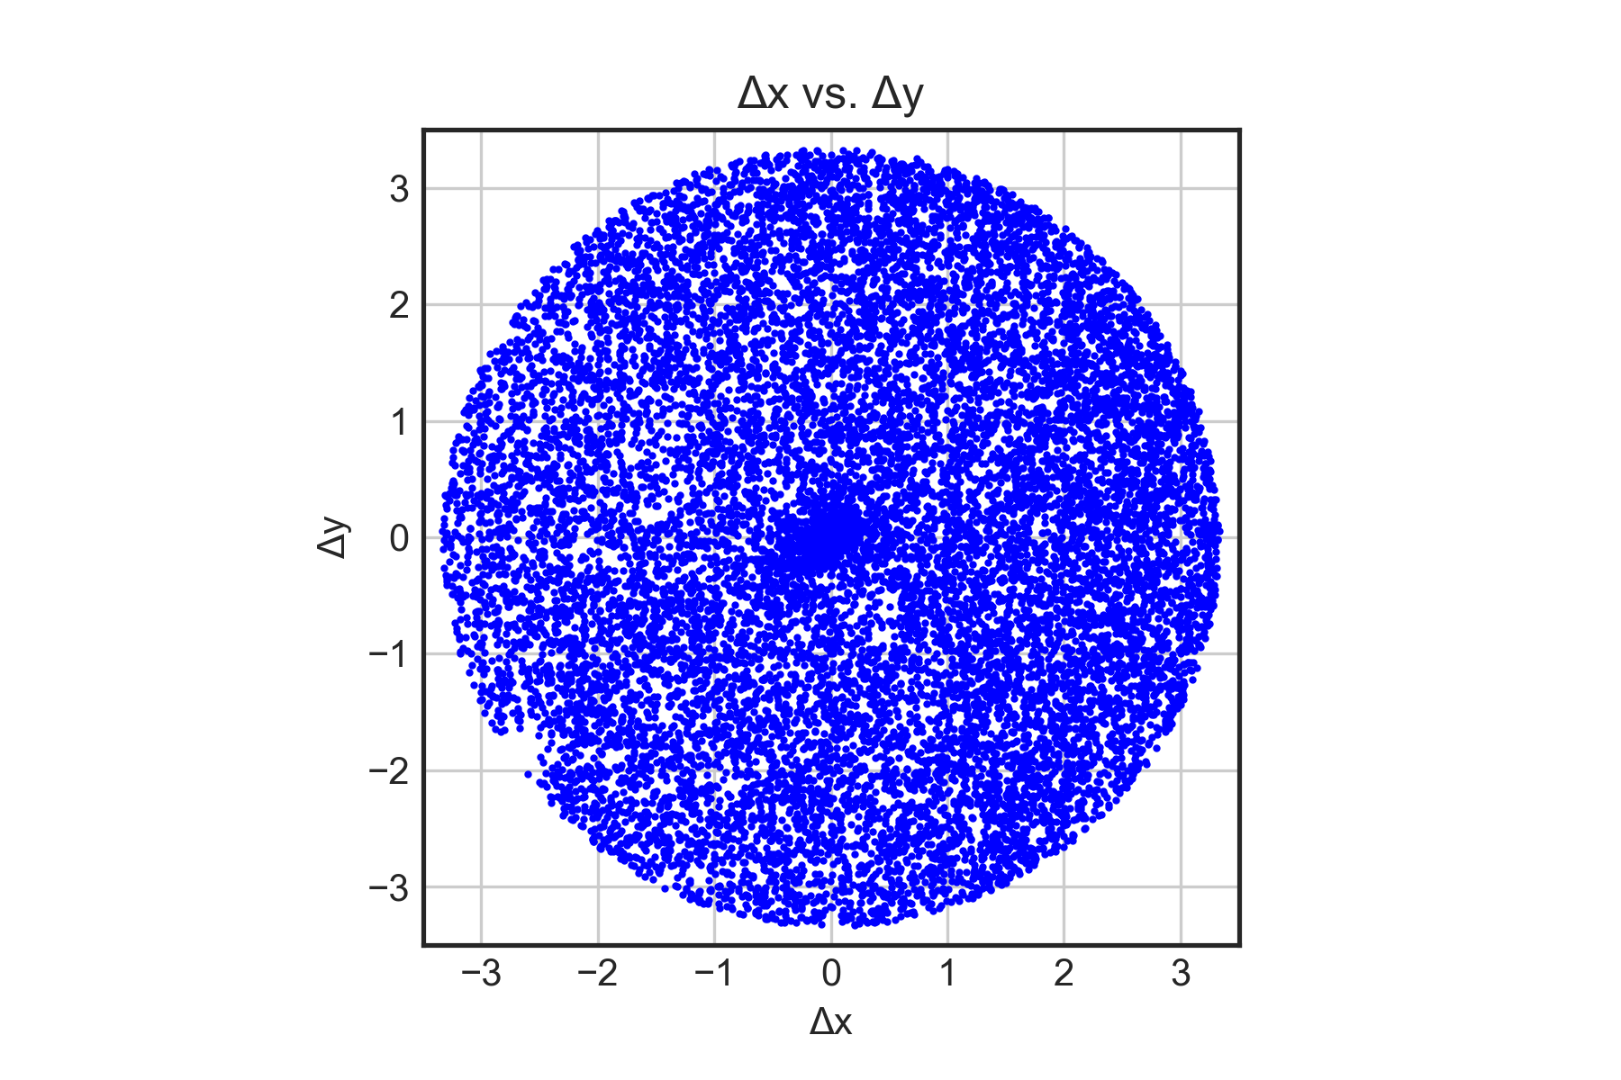
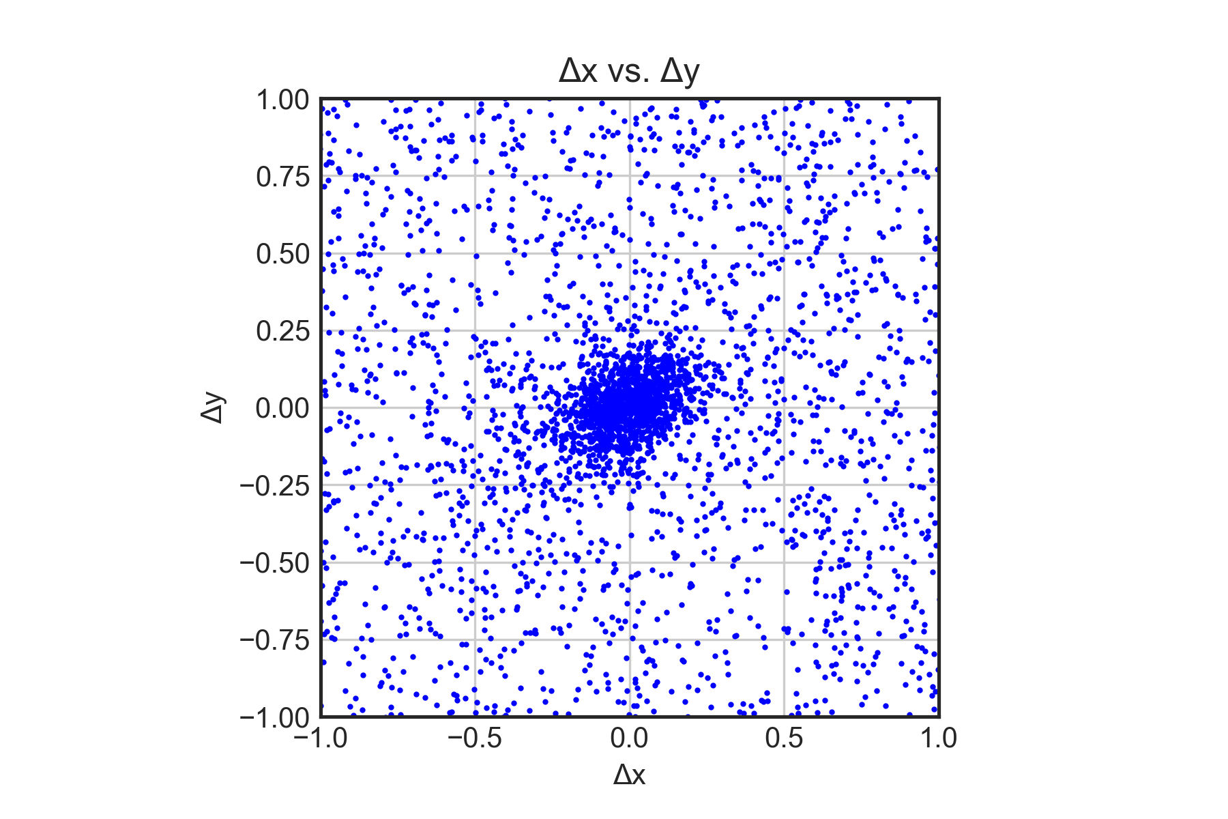
Tangent Plane Projection

Slide 20
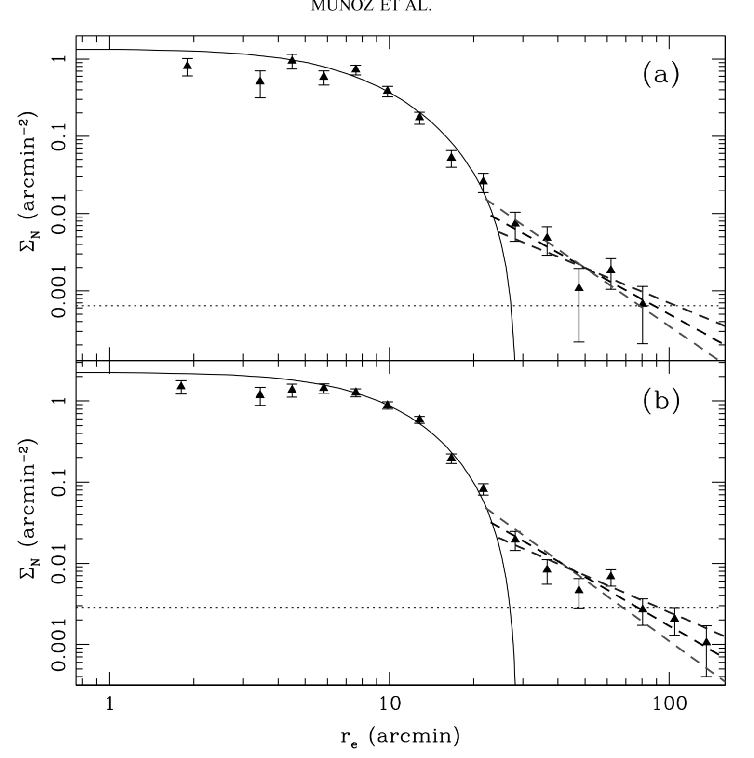
Previous findings
Munoz et. Al., 2006

Slide 21
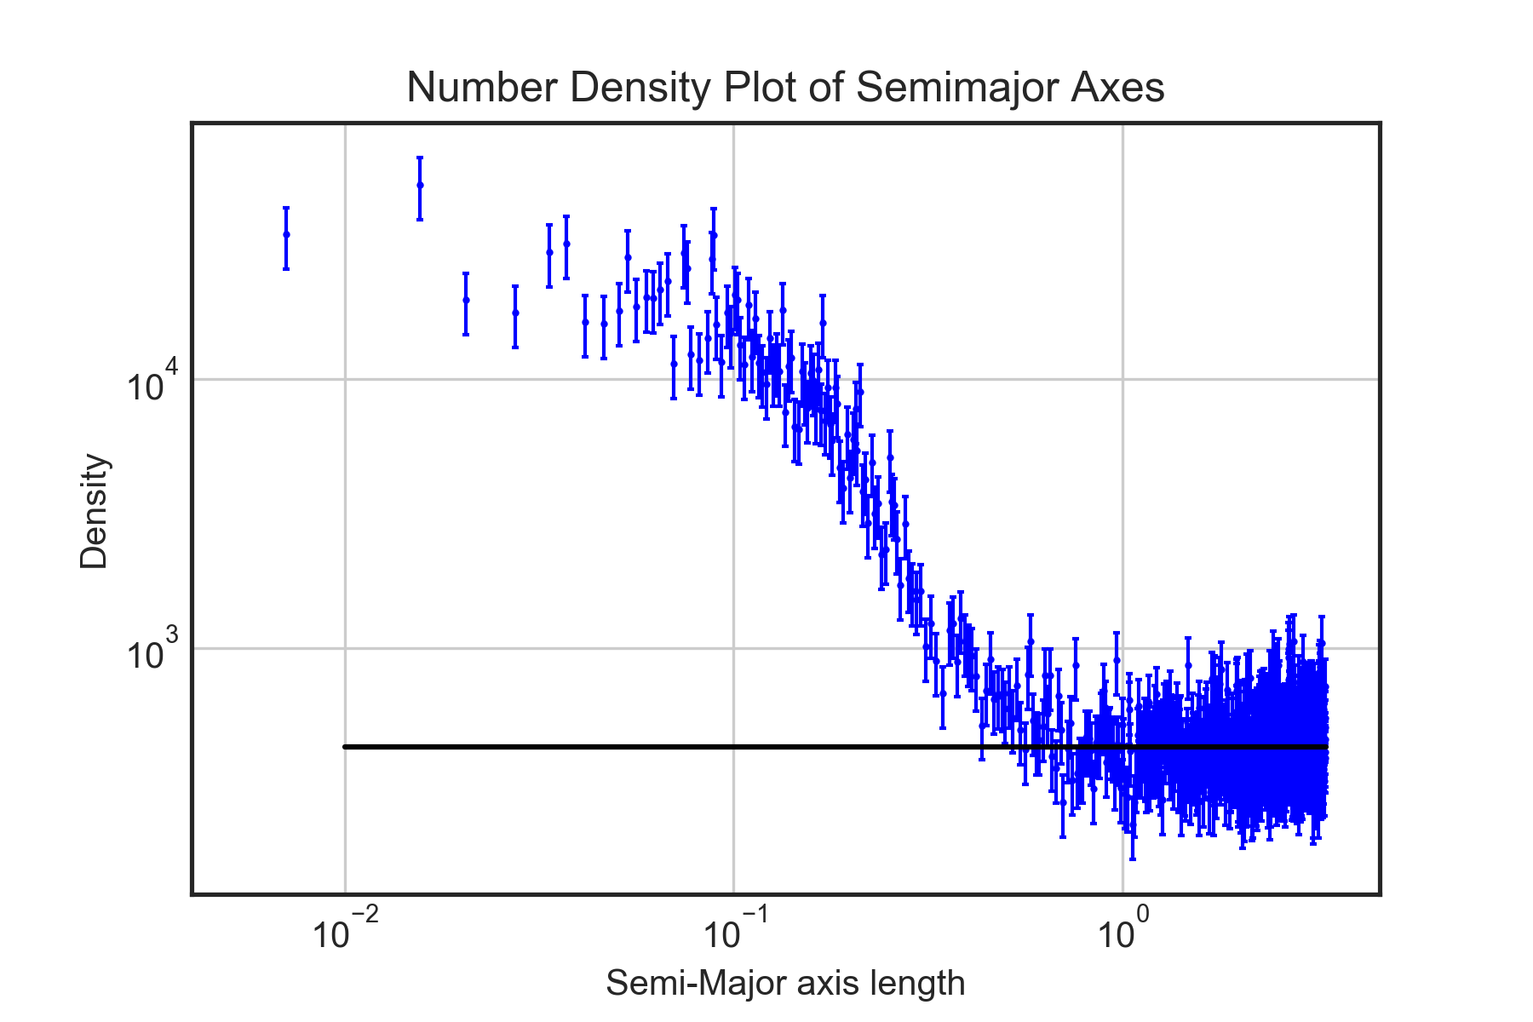
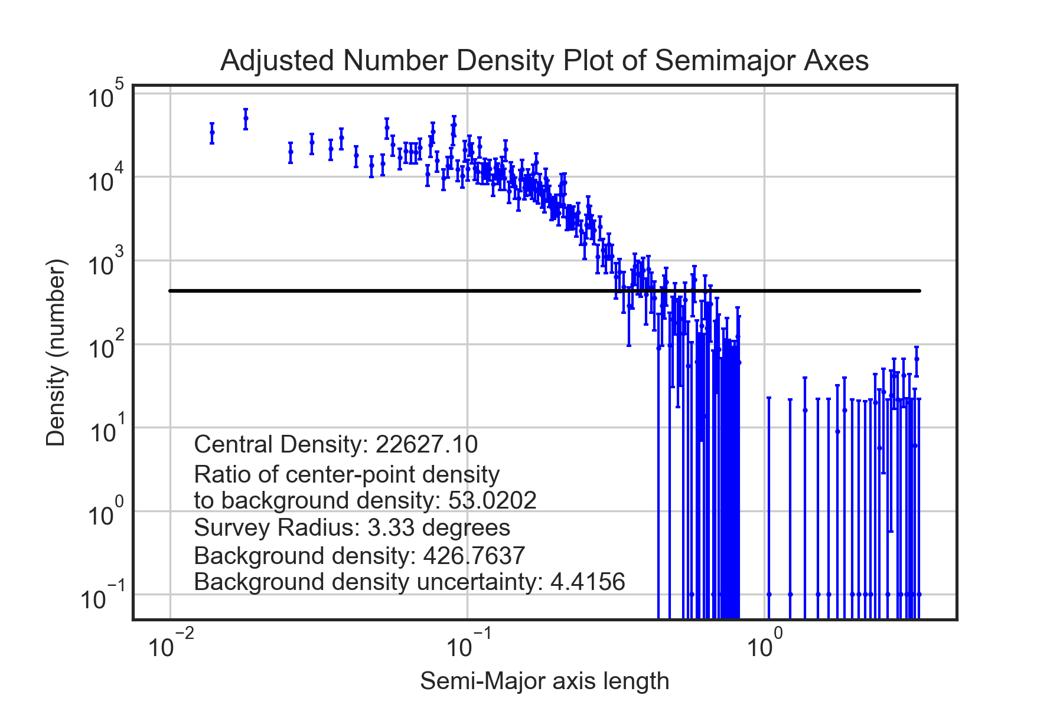
Radial Density Plots Before and After Background Subtraction

Slide 22
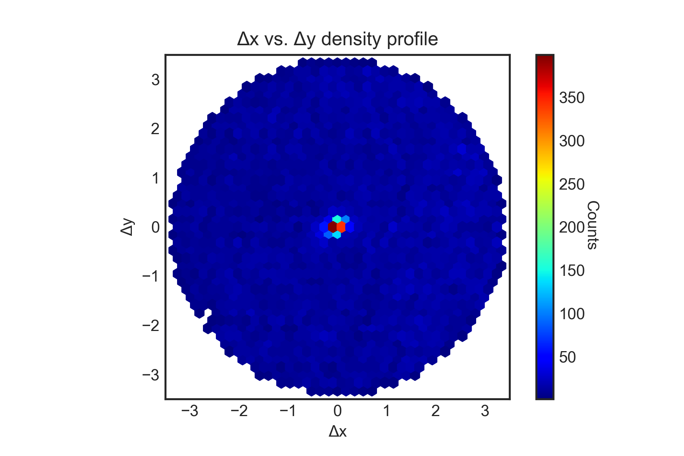
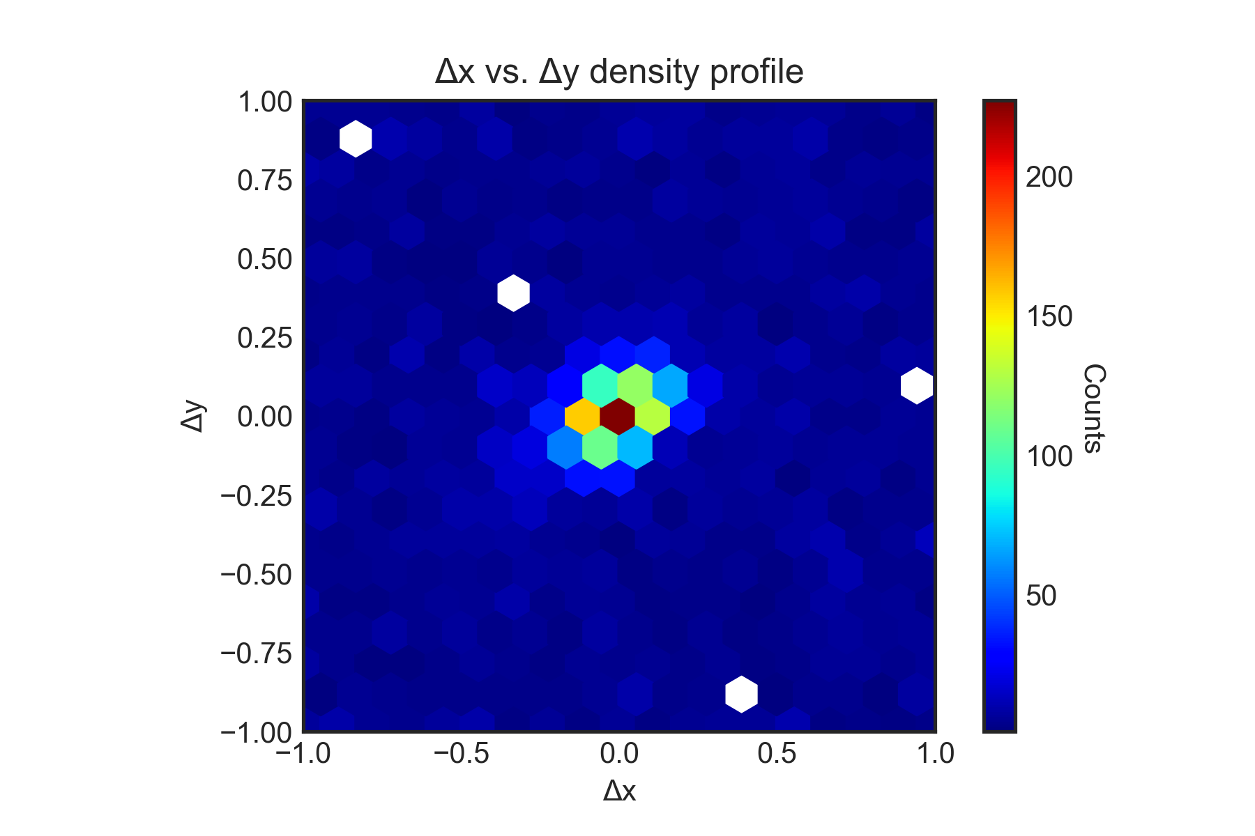
Tangent Plane Projection

Slide 23
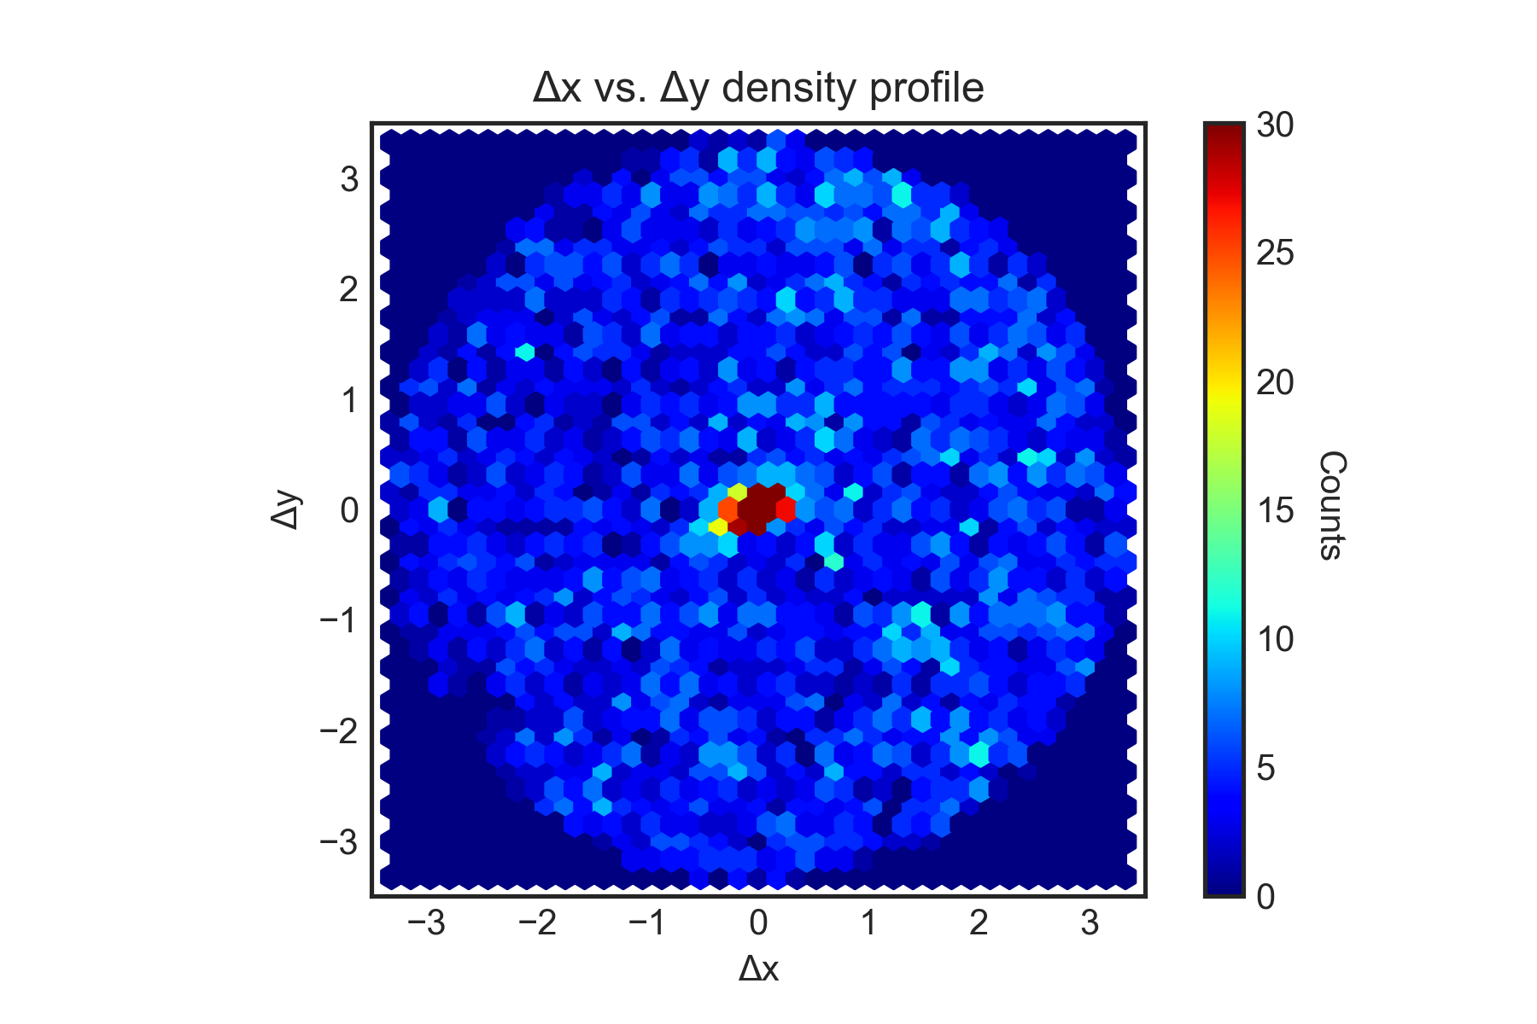
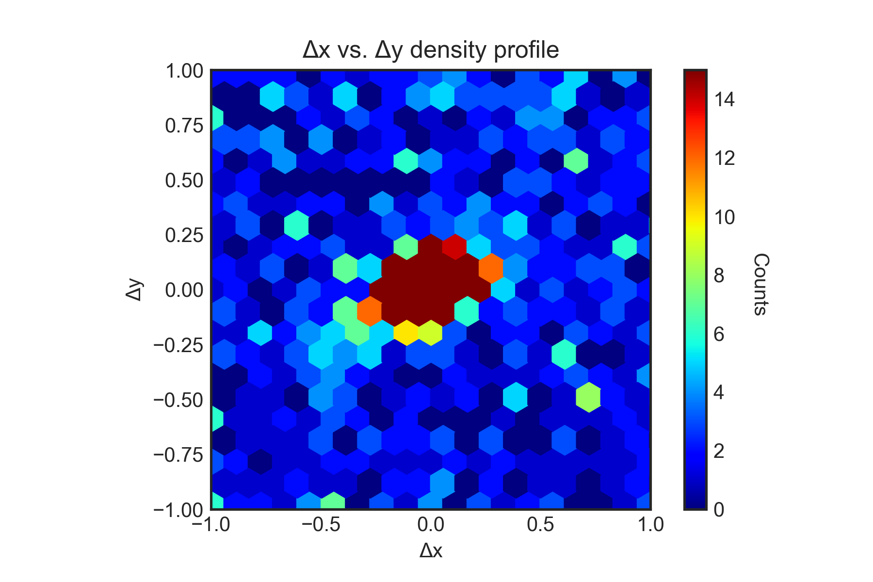
Tangent Plane Projection

Slide 24
Conclusion
No evidence of large-scale tidal tails
Possible small-scale structure close to the galaxy
No strong evidence of tidal effects in the radial profile
In conflict with Munoz et al. (2006)
Future Gaia data releases will provide more precise data
Will allow better removal of foreground non-members using photometry and proper motions
Hence, allowing searches for fainter structures at larger radii

Slide 25
References
Gaia Collaboration, Helmi, A., van Leeuwen, F., et al. 2018b, A&A, in press (arXiv:1804.09381)
Muñoz, R. R., Majewski, S. R., Zaggia, S., et al. 2006, ApJ, 649, 201
Gaia Collaboration, Brown, A.G.A., Vallenari, A., et al. 2018a, A&A, in press (arXiv:1804.09365)
Tools
Matplotlib
Rutgers University – New Brunswick
Jupyter

Slide 26
Images
ESO, and Y Beletsky. “VLT Panorama.” Wikipedia.org, 4 Apr. 2011, commons.wikimedia.org/wiki/File:Panoramic_Large_and_Small_Magellanic_Clouds.jpg.
ESA. “GAIA All Sky Map.” Www.esa.int, 25 Apr. 2018, www.esa.int/spaceinimages/Images/2018/04/Gaia_s_new_map_of_star_density.
“NASA APOD: Mice Galaxies.” Apod.nasa.gov, 6 May 2002, apod.nasa.gov/apod/ap020506.html.
“Carina Dwarf Satellite Galaxy.” Www.eso.org, 27 June 2011, www.eso.org/public/images/potw1126a/.

